Slide 1
LOW LEVEL DOCUMENT
AIR QUALITY INDEX

Slide 2
Input Data and Parameters:
This section represents the input data and parameters required for the air quality prediction model.
It includes various data sources and parameters like air quality data source, weather forecast data source, historical AQI data source, machine learning algorithm, feature extraction, data preprocessing, model training, and performance evaluation metrics.
Air Quality Data Source:
This component represents the source of air quality data used for the prediction.
It could be a dataset containing information about pollutants like Sulphur Dioxide (SO2), Carbon Monoxide (CO2), Nitrogen Dioxide (NO2), and Particulate Matter (PM2.5, PM10).
The data source provides the necessary information for training and evaluating the prediction models.
Weather Forecast Data Source:
This component represents the source of weather forecast data used in conjunction with the air quality data.
It provides information about weather conditions like temperature, humidity, wind speed, etc., which can have an impact on air quality.
Integrating weather forecast data enhances the accuracy of the air quality prediction model.

Slide 3
Historical AQI Data Source:
This component represents the historical Air Quality Index (AQI) data source.
It contains past AQI values for different locations in India, which can be used for model training and evaluation purposes.
Historical data helps in understanding patterns, trends, and seasonality in air quality, enabling better prediction accuracy.
Machine Learning Algorithm:
This section represents the
This section represents the machine learning algorithm used for the air quality prediction model.
It could be regression techniques like Linear Regression (LR), Decision Tree Regressor (DTR), Random Forest (RF), or classification techniques like Logistic Regression (LR), Decision Tree (DT), Random Forest (RF), .
Different algorithms are employed to achieve the best prediction accuracy for AQI scores and classification.
Feature Extraction:
Feature extraction is the process of selecting and transforming relevant features from the input data.
It helps in identifying the most significant factors affecting air quality and capturing their impact on the prediction models.
Feature extraction techniques like Principal Component Analysis (PCA) or domain-specific knowledge can be used.

Slide 4
Data Preprocessing:
Data preprocessing involves cleaning, transforming, and normalizing the input data to ensure its suitability for model training.
It includes tasks like handling missing values, removing outliers, scaling features, and encoding categorical variables.
Proper data preprocessing enhances the performance and robustness of the prediction models.
Model Training:
This component represents the process of training the regression and classification models using the prepared data.
Model training involves splitting the dataset into training and validation sets, applying the chosen machine learning algorithms, and optimizing model parameters.
The trained models capture the relationships between the input features and the target variables (AQI scores and classification labels).
Performance Evaluation Metrics:
Performance evaluation metrics assess the accuracy and effectiveness of the prediction models.
Common metrics include Mean Squared Error (MSE), Root Mean Squared Error (RMSE), Mean Absolute Error (MAE), and Kappa Score.
Regression Model and Classification Model:
This section represents the regression model and classification model used for air quality prediction.
The regression model predicts the AQI score based on the input features, while the classification model classifies the air quality based on predefined categories.
Different algorithms and techniques are employed for regression and classification tasks.

Slide 5
Merging and Prediction:
This component involves merging the outputs of the regression and classification models to generate the final air quality prediction.
The models' predictions are combined based on certain rules or thresholds to provide a comprehensive assessment of air quality.
Performance Evaluation:
Performance evaluation assesses the accuracy of the prediction models and the overall system.
It includes evaluating the model's performance on unseen data, calculating error rates using the chosen evaluation metrics, and comparing the results with predefined thresholds or benchmarks.
Performance evaluation helps in identifying the strengths and weaknesses of the prediction models.
Error Analysis:
Error analysis investigates the discrepancies between the predicted and actual values.
It helps in identifying patterns, specific areas of improvement, and potential causes of prediction errors.
Error analysis guides the refinement and enhancement of the air quality prediction system.
AQI Prediction and Classification:
This section represents the final output of the air quality prediction system, which includes the predicted AQI score and the classification of air quality.
The prediction and classification results provide information about the current air quality status and its potential impacts on health.

Slide 6
Air Quality Index (AQI) Display:
This component visually displays the predicted AQI score and the classification of air quality.
It can use color-coded indicators, textual labels, or graphical representations to convey the air quality information effectively.
Audio Controls:
Audio controls enable the user to control the playback of audio associated with the air quality prediction system.
It includes buttons to play or pause the audio, providing an interactive and engaging user experience.
Deployment in Flask Server:
This section represents the deployment of the air quality prediction system using Flask, a Python web framework.
The system is deployed as a web application accessible through a Flask server.
Flask allows hosting the prediction system on a local or remote server, making it accessible to users through a web browser.
Tools Used:
The air quality prediction system is built using various tools like HTML, JavaScript, and CSS for frontend development.
Flask is used as the backend framework to handle HTTP requests, data processing, and model inference.
Machine learning libraries such as scikit-learn or TensorFlow are utilized for implementing the prediction models and evaluation metrics.

Slide 7
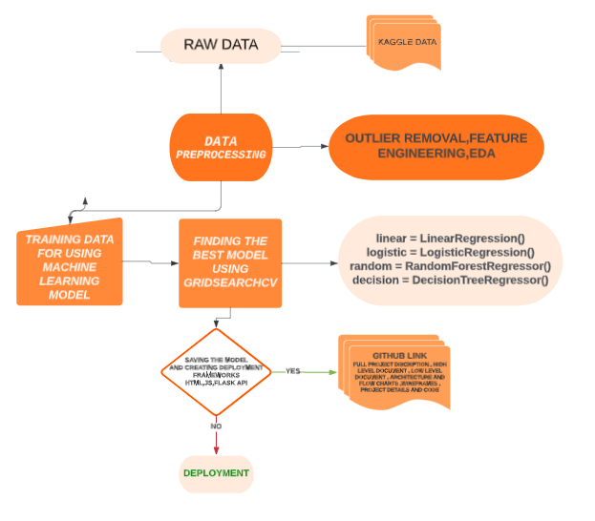
ARCHITECTURE

Slide 8
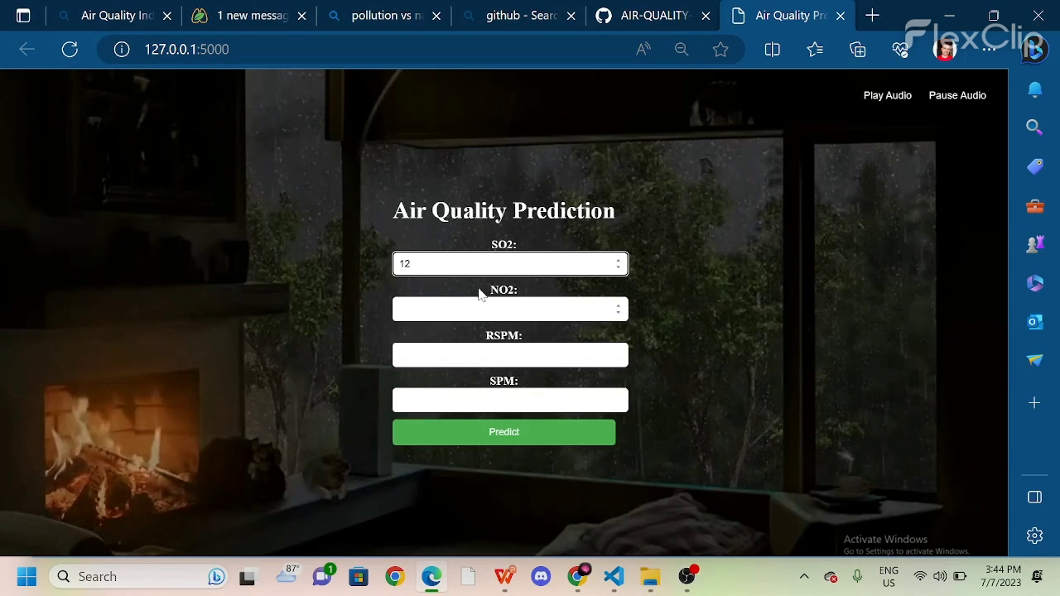
DEPLOYMENT

Slide 9
THANK YOU

